Slide 1
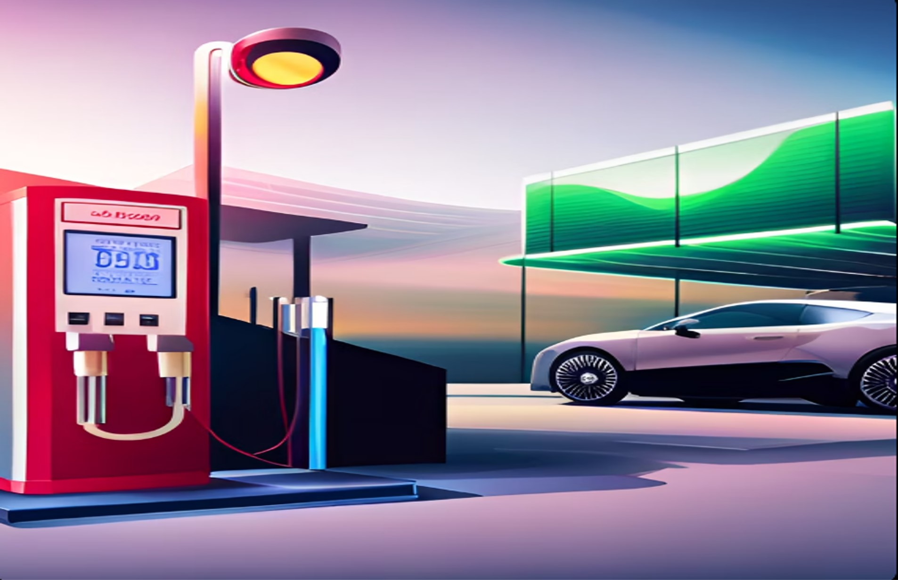
PETROL PUMP MANAGEMENT SYSTEM
Presented by:
SANDRA K MATHEW
22PMC147

Slide 2

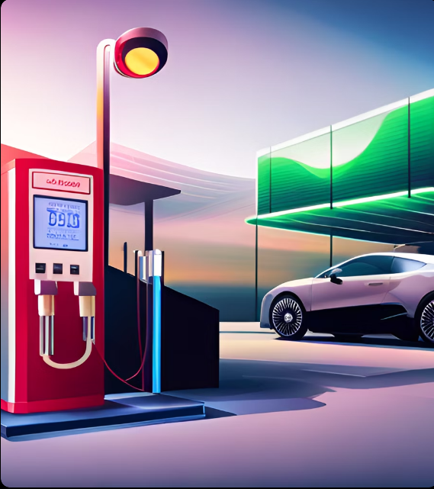
PETROL PUMP MANAGEMENT SYSTEM
Features
Conclusion
Introduction
Abstract
Requirements
Technical Aspects
Architecture
Database
Future Enhancement
Reference
TABLE OF CONTENTS

Slide 3
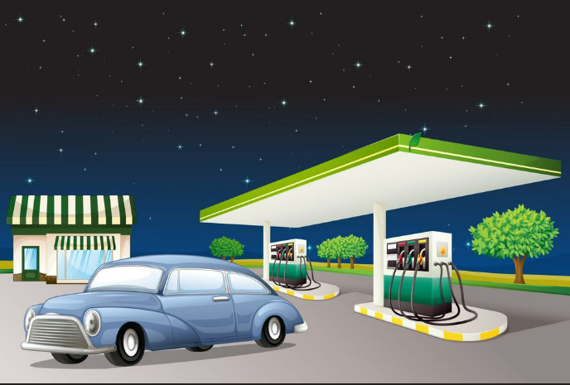

Introduction
The petrol pump management system website is an innovative solution to streamline the operations of a petrol pump.
It offers a range of features that enable the petrol pump owner as well as the employees to manage the business efficiently and effectively.

Slide 4
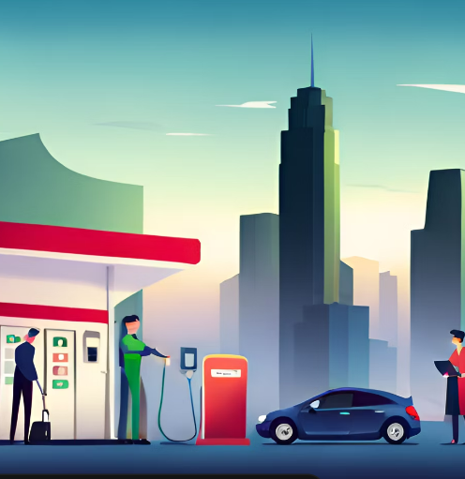

Abstract
Key features of this website include real-time monitoring of fuel levels and transactions, robust inventory management tools, secure user authentication and access control, comprehensive reporting and analytics functionalities, and seamless integration with existing enterprise systems. These features empower businesses to gain actionable insights, optimize fuel consumption, reduce operational costs, and ensure regulatory compliance.
The Petrol pump management system website serves as a centralized platform that enables petroleum businesses to efficiently manage their fuel-related activities, such as fuel procurement, inventory control, and sales.
The system automates manual processes, enhance data accuracy, and improve decision-making capabilities.

Slide 5
Requirements
User Management
Fuel Inventory Management
Fuel Dispensing
Sales and Financial Reporting
Price Management
User-friendly Interface

Slide 6
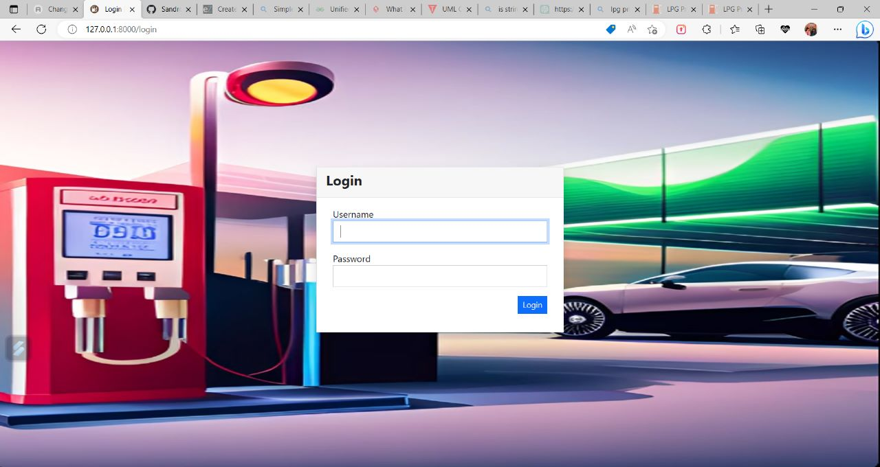
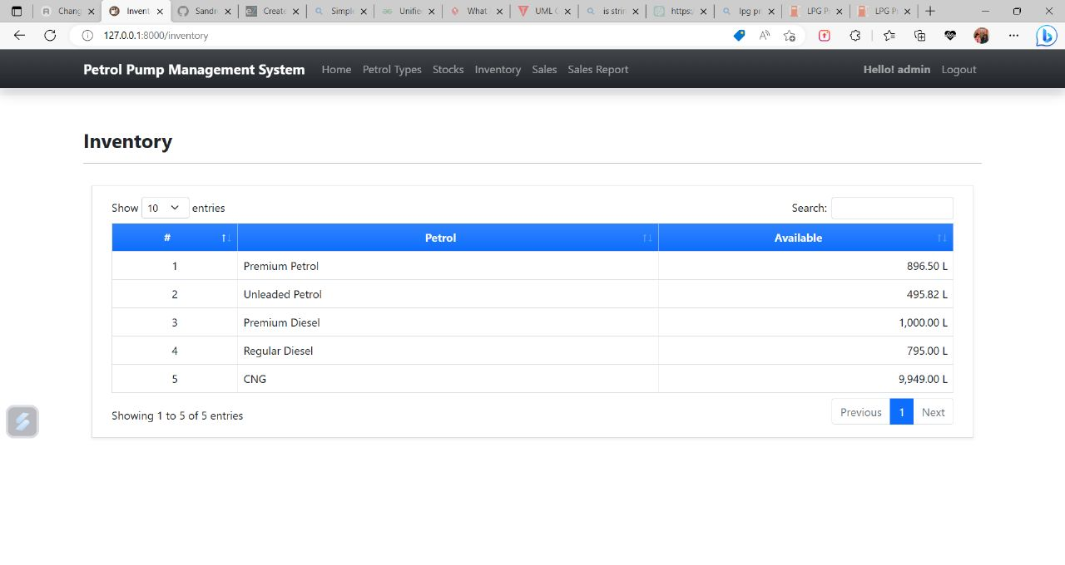
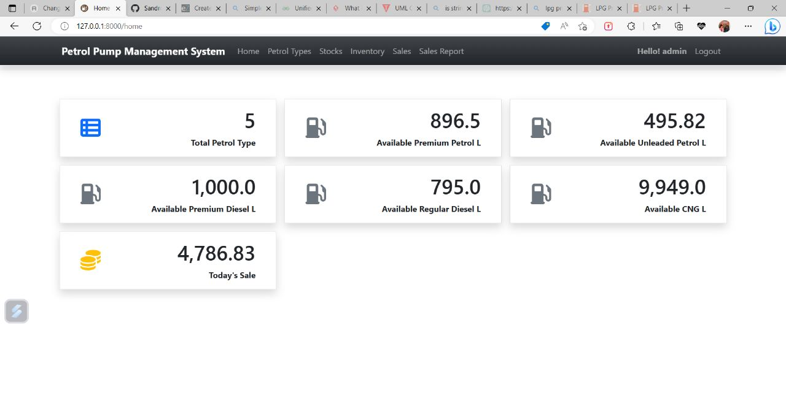
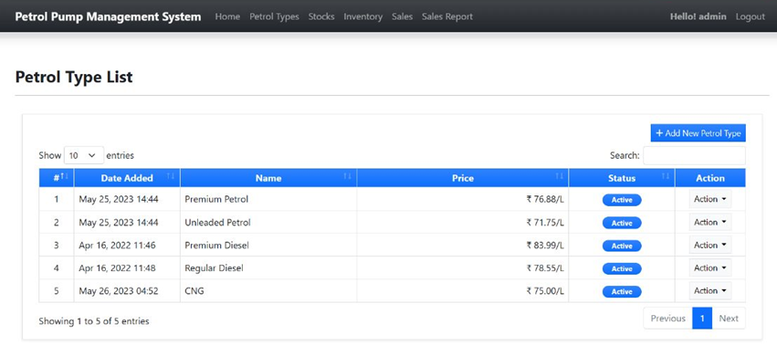
Features
PETROL TYPE MANAGEMENT
INVENTORY PAGE
HOME
LOGIN
Add new petrol
Delete petrol
Edit petrol details
View petrol details
List all petrol types
Displays the summary

Slide 7
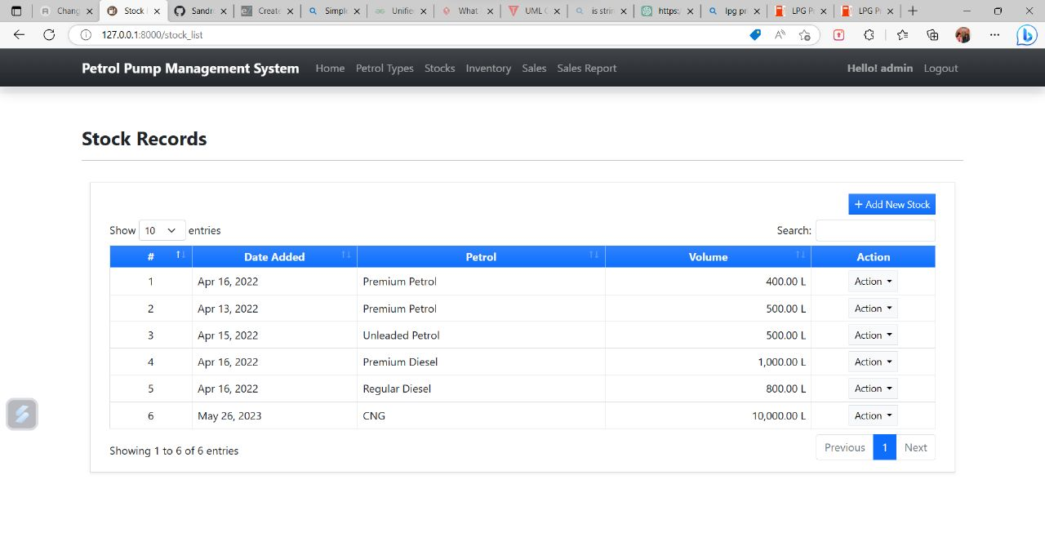
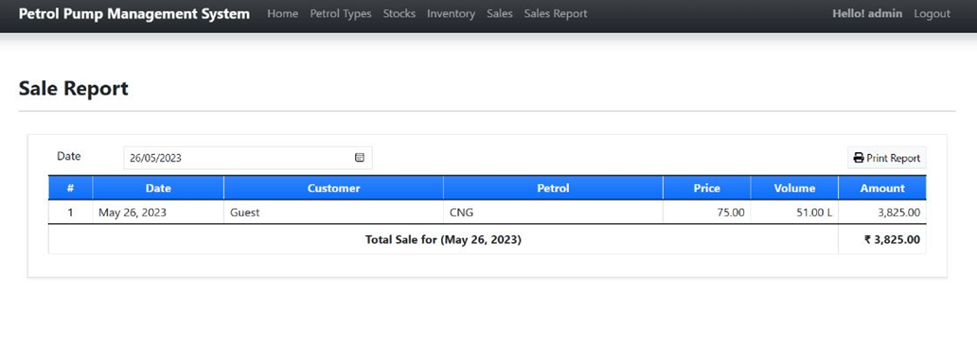
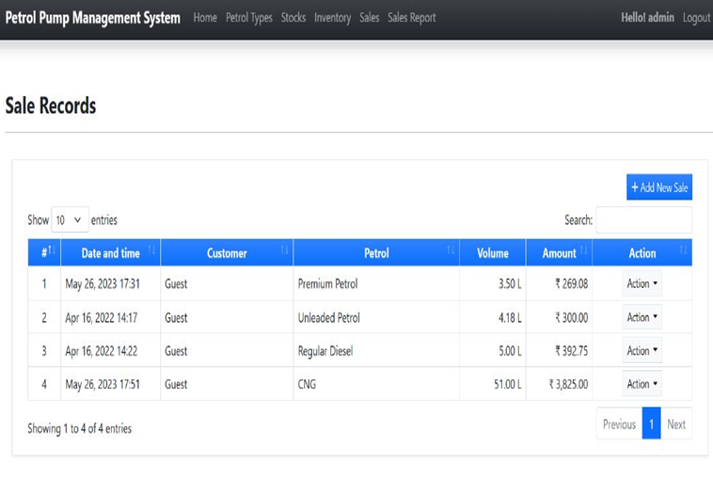
Features
SALES MANAGEMENT
GENERATE /PRINT DAILY SALES REPORT
STOCK IN MANAGEMENT
Add new Sale Transaction
List all Sales Records
View /edit sale details
Delete sale
Add new petrol Volume/Stock
List all stock in records
View stock in details
Edit stock-in details
Delete stock-in details

Slide 8
Technical Aspects
Python
SQLite3
Django
JavaScript
HTML
CSS
Bootstrap 5

Slide 9
Architecture follows a client -server model, where the client (web browser) sends requests to the server (Django application), which processes the requests, interacts with the database, and generates responses to be sent back to the client.
Models
Views
Templates
URL Configuration
Static Files etc
Architecture

Slide 10
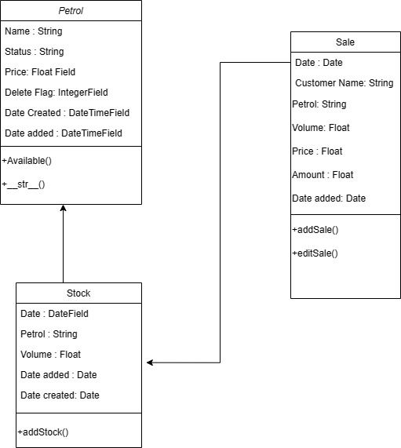
Database
Class Diagram

Slide 11
Future Enhancement
Add/delete employee
Add/ view/edit employee details
Employee management
Task scheduling

Slide 12

Conclusion
The petrol pump management system provides an efficient solution for managing various aspects of a petrol pump.
With its user-friendly interface and efficient features, the system improves the overall management and operations of a petrol pump, leading to enhanced productivity, accuracy, and customer satisfaction.

Slide 13

Reference
Stack Overflow: https://stackoverflow.com/
ChatGPT
Django Jazzmin Documentation: https://django-jazzmin.readthedocs.io/

Slide 14
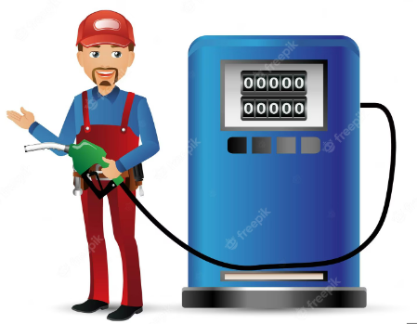
THANK YOU

Slide 15
